Slide 1
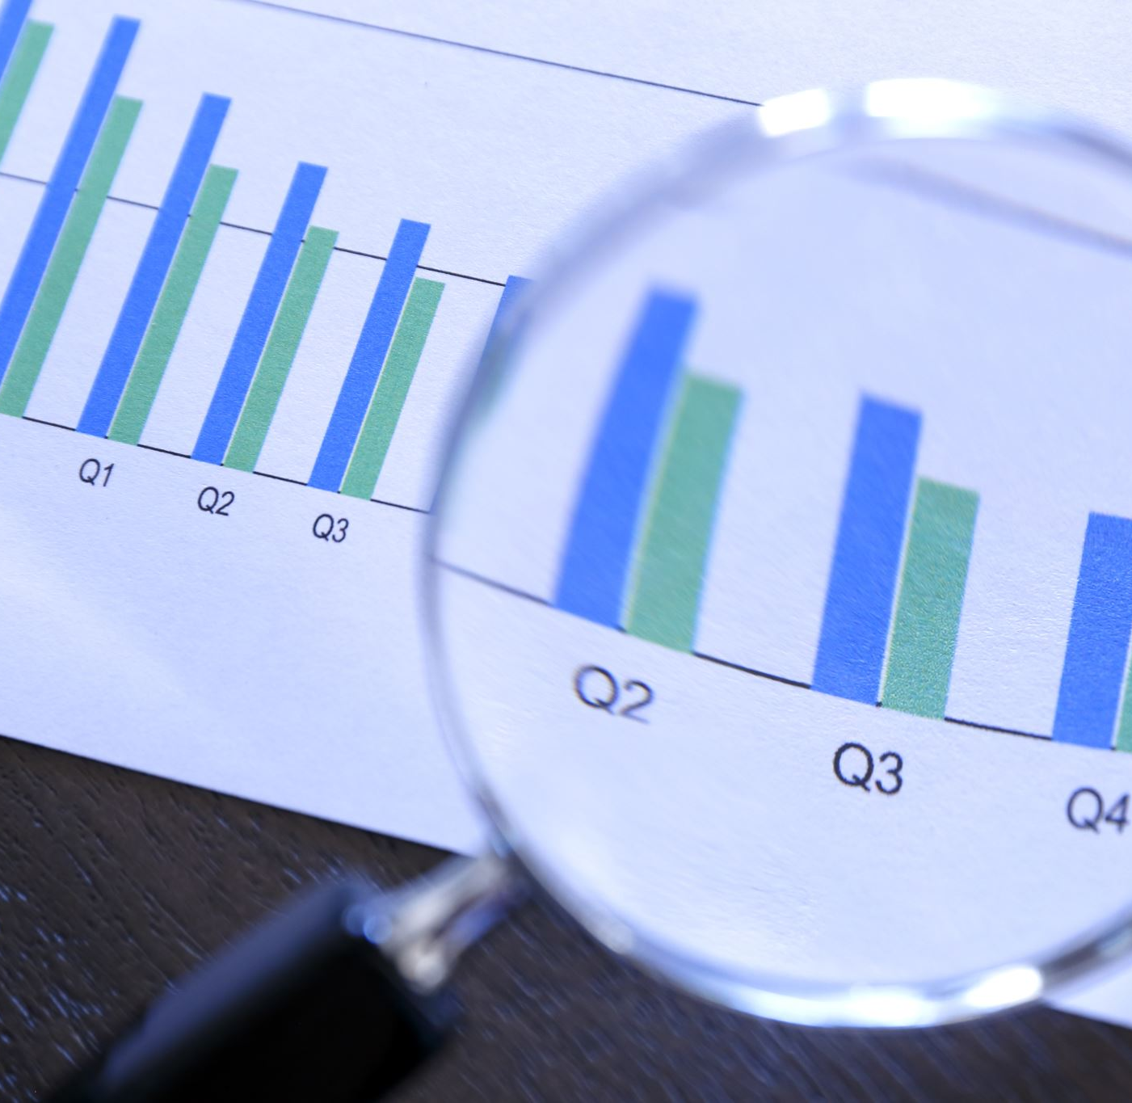

DATA608: Knowledge and Visual Analytics
Discussion: Time, and Pictorial Instructions
November 30th, 2022
Chinedu Onyeka

Slide 2

Concept of Time
Time is the continued sequence of existence and events that occurs in an apparently irreversible succession from the past, through the present, into the future.
- Wikipedia
Time is a measure of non-stop, consistent change in our surroundings, usually from a specific viewpoint - Science Alert
A finite extent or stretch of continued existence, as the interval separating two successive events or actions, or the period during which an action, condition, or state continues; a finite portion of time (in its infinite sense); a period. - Oxford English Dictionary

Slide 3


Passage of Time
Passage of Time: The process by which time passes.

Slide 4
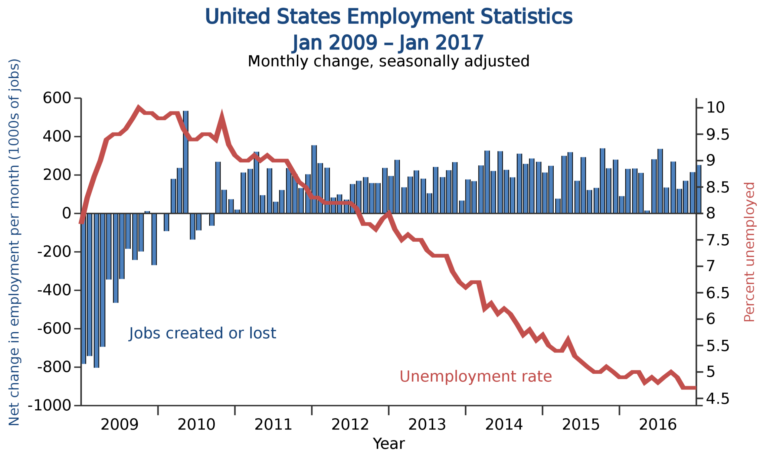
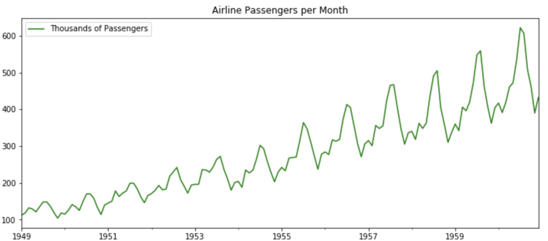
Time Series
Time Series: A time series is a sequence of data points that occur in successive order over some period of time. This differs from cross-sectional data which captures a certain point in time.

Slide 5
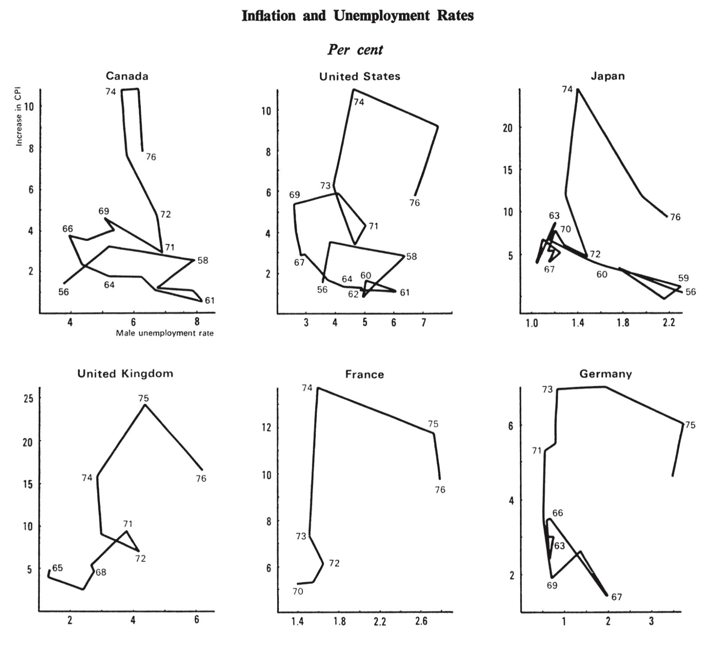
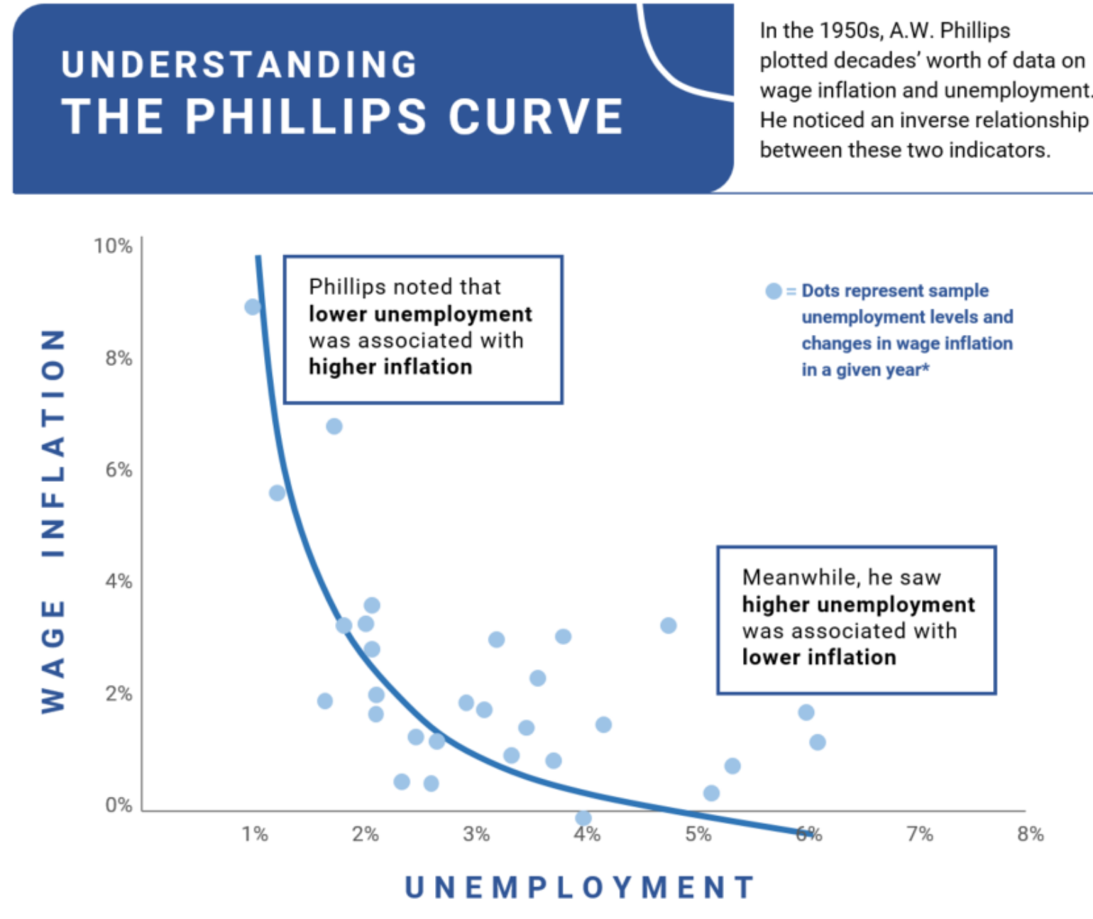
Phillips Curve: Inflation and Unemployment Rates
Phillips Curve: The Phillips curve is an economic theory that inflation and unemployment have a stable and inverse relationship

Slide 6
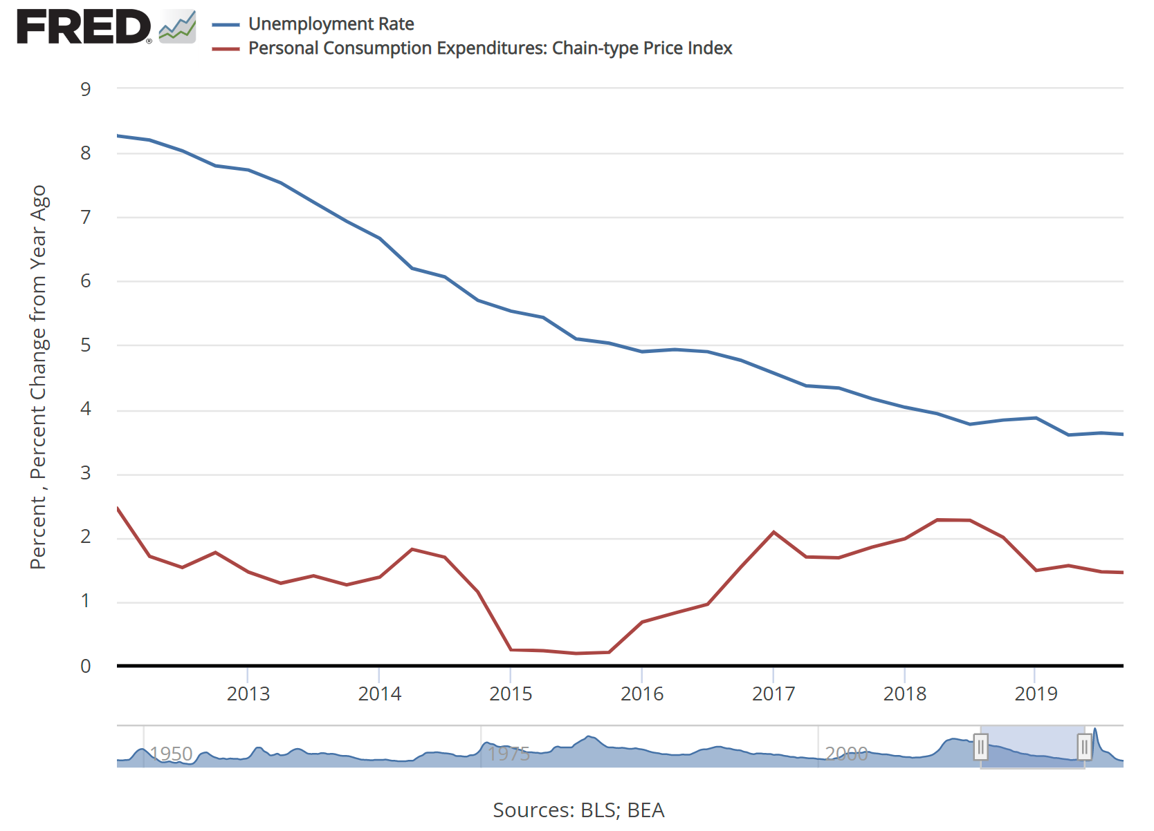
Phillips Curve: Inflation and Unemployment Rates

Slide 7
References
Bennie, M. (2022, April 18). Teaching the Concept of Time. Autism Awareness. https://autismawarenesscentre.com/teaching-the-concept-of-time/
GeeksforGeeks. (2020, February 19). Python | ARIMA Model for Time Series Forecasting. https://www.geeksforgeeks.org/python-arima-model-for-time-series-forecasting/
Engemann, K. M. (2021, December 9). What Is the Phillips Curve (and Why Has It Flattened)? https://www.stlouisfed.org/open-vault/2020/january/what-is-phillips-curve-why-flattened
Mangla, B. (2018, November 23). Age is Just a Number! - Bhavya Mangla. Medium. https://medium.com/@bhavyamangla/age-is-just-a-number-937b7701c58d
Staff, S. (2021, February 27). What Is Time? : ScienceAlert. https://www.sciencealert.com/time
The Work of Edward Tufte and Graphics Press. (n.d.). https://www.edwardtufte.com/tufte/
time, n., int., and conj. : Oxford English Dictionary. (n.d.). https://www.oed.com/viewdictionaryentry/Entry/202100
Theme Park Tribune. (2018, March 15). the-passage-of-time-1170x630. https://www.themeparktribune.com/the-passage-of-time-1170x630/
What Is a Time Series and How Is It Used to Analyze Data? (2022, June 13). Investopedia. https://www.investopedia.com/terms/t/timeseries.asp
Wikipedia contributors. (2022b, November 16). Unemployment in the United States. Wikipedia. https://en.wikipedia.org/wiki/Unemployment_in_the_United_States
Wikipedia contributors. (2022, October 23). Time. Wikipedia. https://en.wikipedia.org/wiki/Time

Slide 8

Questions

